Slide 1
Rosserial and Arduino IDE
Setup

Slide 2
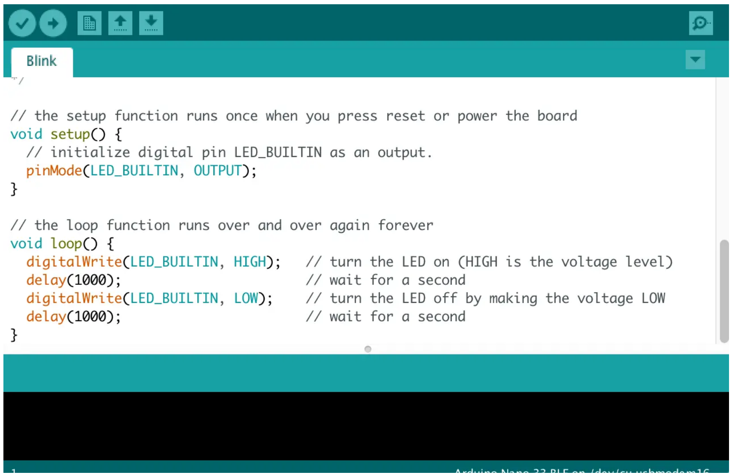
Arduino IDE
Configuring the Arduino IDE
The Arduino and Arduino IDE are great tools for quickly and easily programming hardware.
The rosserial_arduino package, allows the usageof ROS directly with the Arduino IDE.
Rosserial provides a ROS communication protocol that works over your Arduino's UART.
Rosserial, allows Arduino to be a ROS node which can directly publish and subscribe to ROS messages, publish TF transforms, and get the ROS system time.
Arduino IDE can also be used to program the Hackerboard and other microcontrollers like the ESP32.
Arduino IDE

Slide 3
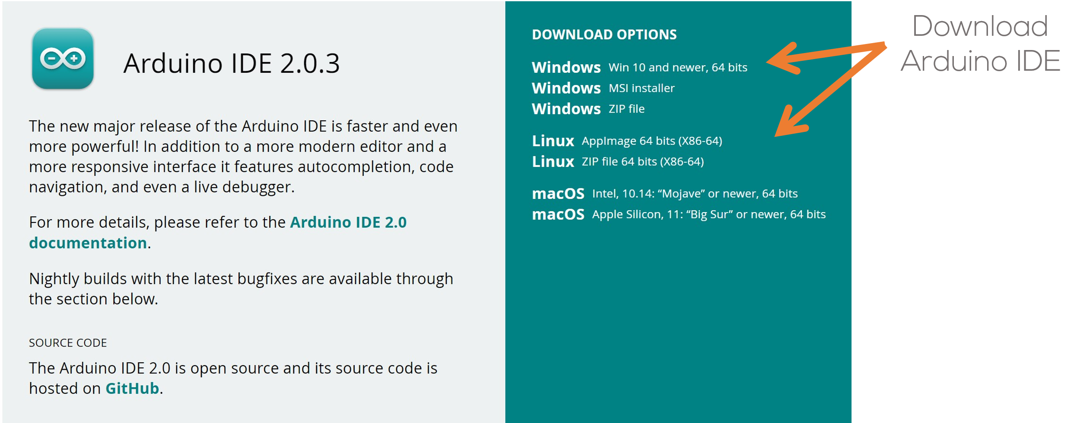
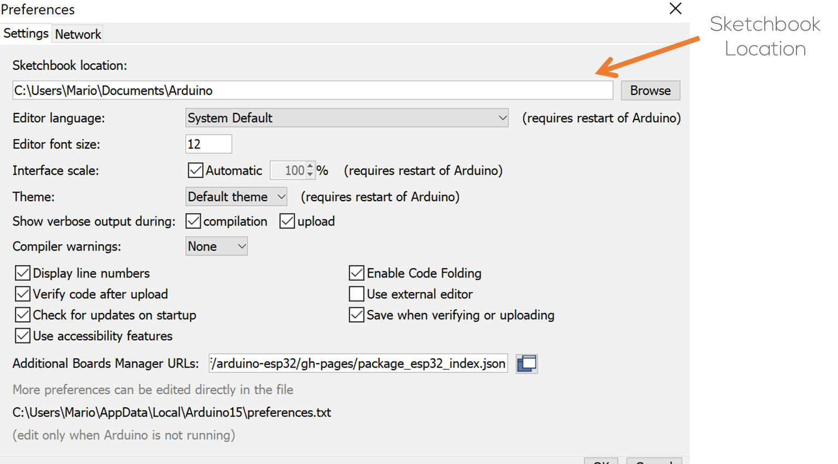
Arduino IDE
Installation
Download the Arduino IDE from the website.
Install the Arduino IDE application into a folder on the desktop (Windows), or home folder (Ubuntu).
Follow the installation instructions for Windows and Linux here.
Once installed, launch the application if you want to select your sketchbook location (File>>Preferences>>Sketchbook location).
Sketchbook is a standard place to store your programs, or sketches.
Close the IDE when done.
Note: The Arduino IDE can be installed in the Virtual Machine, following the same steps.

Slide 4
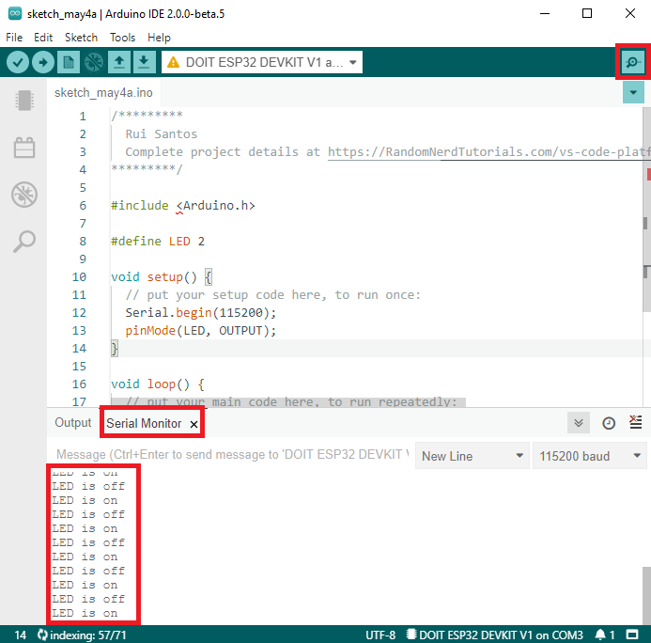
Arduino IDE-ESP32 Setup
Arduino IDE – ESP32 and Hackerboard setup
To install the ESP32 libraries follow the steps in any of the following links.
Simple tutorial (not official)
Simple tutorial Arduino IDE 2.0 (not official)
Espressif Tutorial (official)
Official Github
Connect the Hackerboard/ESP32 to the computer.
Test the installation using the example (at the end) here or here.

Slide 5
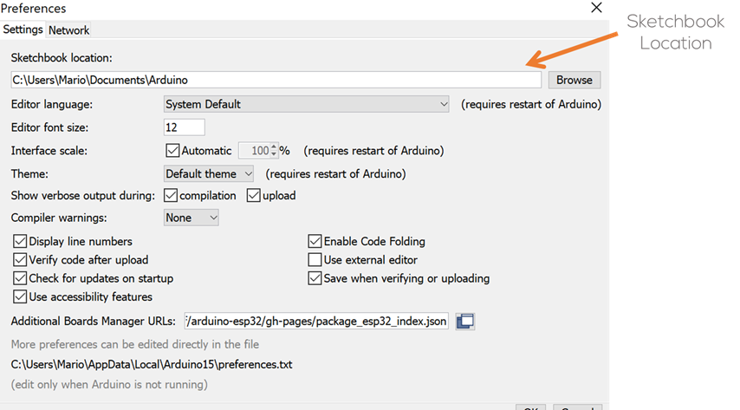
Install the ROS Libraries for Arduino
To setup the Arduino IDE follow the steps here. In the section Installing the software. This setup is for ubuntu systems only or VM.
Where ROS_DISTRO can be obtained running the following command on the terminal.
Go to the sketchbook folder (previous slide) and right click to open in terminal.
If you are building Arduino on Windows, copy the ros_lib directory from Linux to the Windows sytem's sketchbook/libraries folder (typically found in My Documents).
*Note: Currently you can install the Arduino libaries directly in the Arduino IDE. Just open the Library Manager from the IDE menu in Sketch -> Include Library -> Manage Library. Then search for "rosserial". This is useful if you need to work on an Arduino sketch but don't want to setup a full ROS workstation.
sudo apt-get install ros-${ROS_DISTRO}-rosserial-Arduino
sudo apt-get install ros-${ROS_DISTRO}-rosserial
rosversion -d
cd <sketchbook>/libraries
rm -rf ros_lib
rosrun rosserial_arduino make_libraries.py .

Slide 6
Port Permissions (Ubuntu)
To use Arduino or the ESP32 in Ubuntu, the user must give permissions to the system for accessing ports.
Make sure the port permissions are granted for the user.
In a new terminal type cd ~/dev to visualise the port designated by Ubuntu to the MCU. This port are usually called /ttyACM0 or /ttyUSB0.
Having obtained the name of the port type the correspondent command to enable the permissions (replace the asterisk with the port number).
To make the change permanently, follow the steps here.
sudo chmod 666 /dev/ttyACM*
sudo chmod 666 /dev/ttyUSB*

Slide 7
Troubleshoot
Common problems with Arduino IDE

Slide 8
USB Ports in VM
When connecting a USB to a VM several steps must be performed for the virtual machine to be able to recognise the USB Port from the host computer. More information can be found here.
Make sure the correct drivers for the device are installed in the host computer. More information can be found here.
Give permissions to the VM to access the USB ports of the host machine. More information can be found here and here.
A video tutorial on how to connect USB devices to the VMWare Player can be found here.

Slide 9
Troubleshoot
Troubleshooting
When compiling for the ESP32 the following error appears
“Missing Python: “python”: executable file not found in $PATH”
To avoid this error, you can install the python-is-python3 package to create the symbolic links.
sudo apt install python-is-python3
When compiling the following error appears
“ImportError: No module named serial”
To avoid this error, install the pyserial library
sudo apt install python3-pip
pip3 install pyserial
Additional Troubleshoot can be found here, here and here.

Slide 10
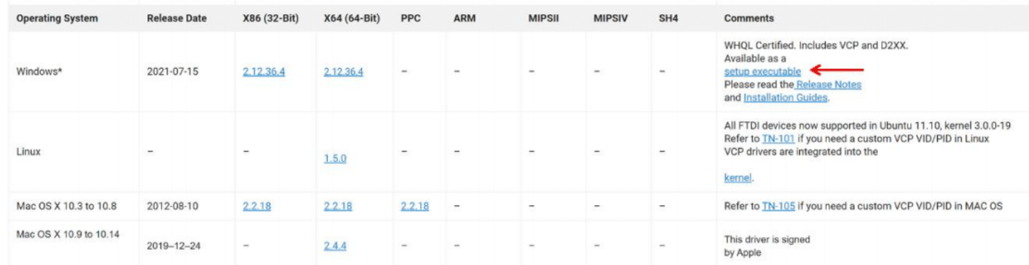

Troubleshoot
Troubleshoot (Drivers)
Drivers are usually installed automatically by Windows and Ubuntu even for the Virtual Machines.
How do I know if the drivers are properly installed (Windows)?
Plug the Puzzle-Bot into the USB port.
Go to Start > Device Manager
The Serial port should appear as shown in the following figure (The COM port may vary).
If the computer cannot find the drivers, download the drivers from the following link
https://ftdichip.com/drivers/vcp-drivers/
Verify that the USB cable is a data cable and not only a power cable!
Scroll down and download the executable setup as shown in the following figure
Before Installing the drivers!!
Unplug the Puzzle-Bot from the computer.
Unzip the drivers and run the setup (some computers are required to be restarted after the installation).
Plug the Puzzle-Bot back into the computer.

Slide 11
Troubleshoot
Troubleshoot (Drivers)
Some Hackerboards have a different USB-UART chip the CP210x.
Drivers are usually installed automatically by Windows and Ubuntu even for the Virtual Machines.
Verify if they are installed by following the steps in the previous slide.
Verify that the USB cable is a data cable and not only a power cable!.
If the computer cannot find the drivers, download the drivers from the following link
https://www.silabs.com/developers/usb-to-uart-bridge-vcp-drivers?tab=downloads
Before Installing the drivers!!
Unplug the Puzzle-Bot from the computer.
Unzip the drivers and run the setup (some computers are required to be restarted after the installation).
Plug the Puzzle-Bot back into the computer.
A troubleshoot guide can be found here.

Slide 12
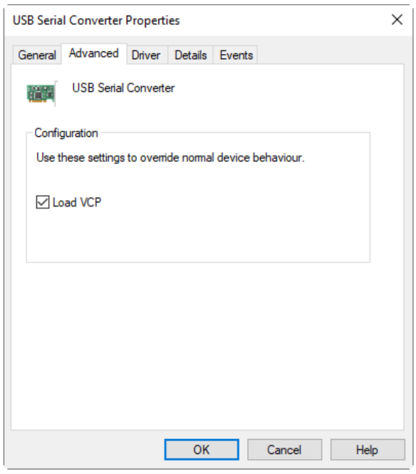
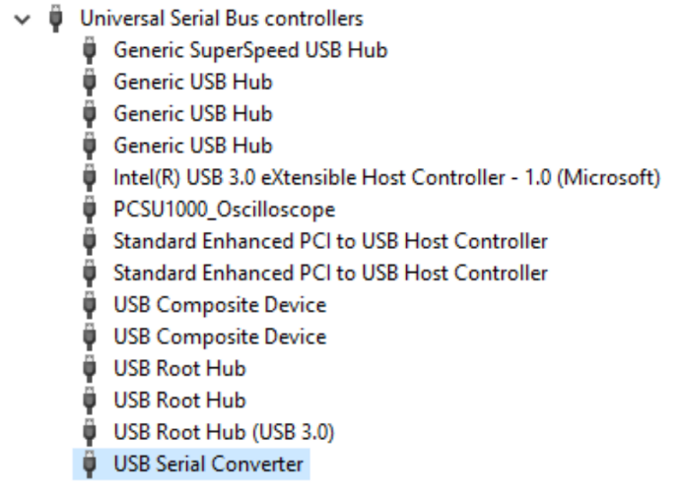
Troubleshoot
Troubleshoot (Drivers)
My computer still not recognize the drivers even after the installation
Plug the Puzzle-Bot into the USB port.
Go to Start > Device Manager.
Look for the USB Serial Converter as shown in the following picture.
Right Click to Properties > Advanced Tab.
Make sure the Load VCP box is checked.
Reconnect the Puzzle-Bot to the computer.
FIGURE: USB SERIAL CONVERTER
FIGURE: VCP PORT

Slide 13
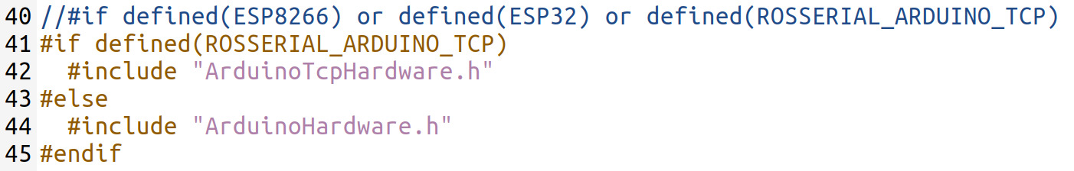
Troubleshoot
Rosserial: Mismatched Protocol Error
When using rosserial with Arduino, the ESP32 or the Hackerboard in Ubuntu, if the following error message appears:
Mismatched protocol version in packet (b'\xbd'): lost sync or rosserial_python is from different ros release than the rosserial client
Please note that the error message may be slightly different.
Go to your sketchbook (Arduino) Folder, in ubuntu or windows.
In ubuntu, is usually located in “home”. The folder address can be seen in File>Preferences>Sketchbook Location.
In Windows, is usually located in “/Documents/Arduino/”. The folder address can be seen in File>Preferences>Sketchbook Location.
Open the file ros.h in the Arduino/Sketchbook folder:
~/Arduino/libraries/ros_lib/ros.h
~\Documents\Arduino\libraries\Rosserial_Arduino_Library\src\ros.h
Modify line 40 as follows:
Save the file
Restart the Arduino IDE
Recompile and Upload the code to the Hackerboard/ESP32
Test the solution by connecting to the board and uploading an example using a rosserial example (here).

